Slide 1
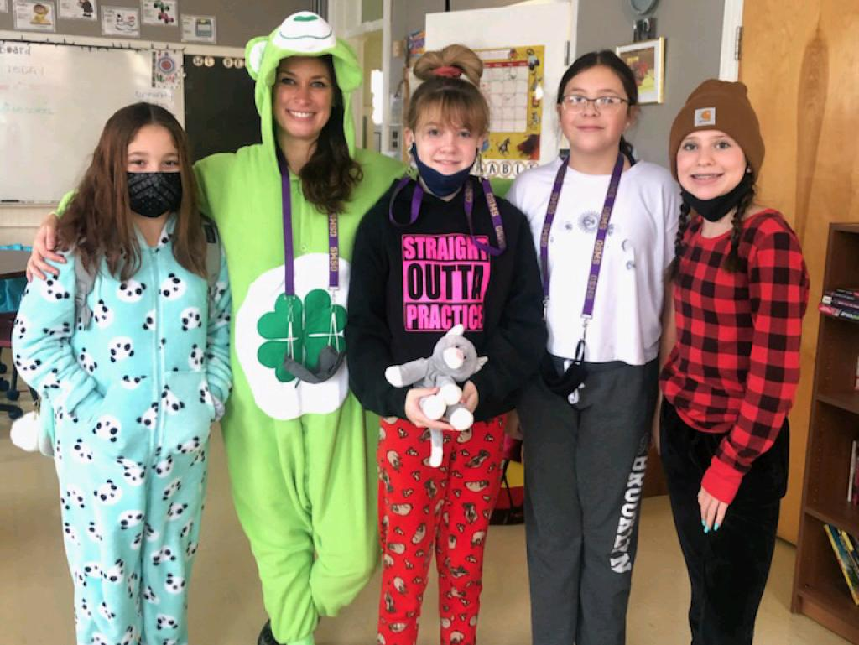
WELCOME TO MIDDLE SCHOOL

Slide 2
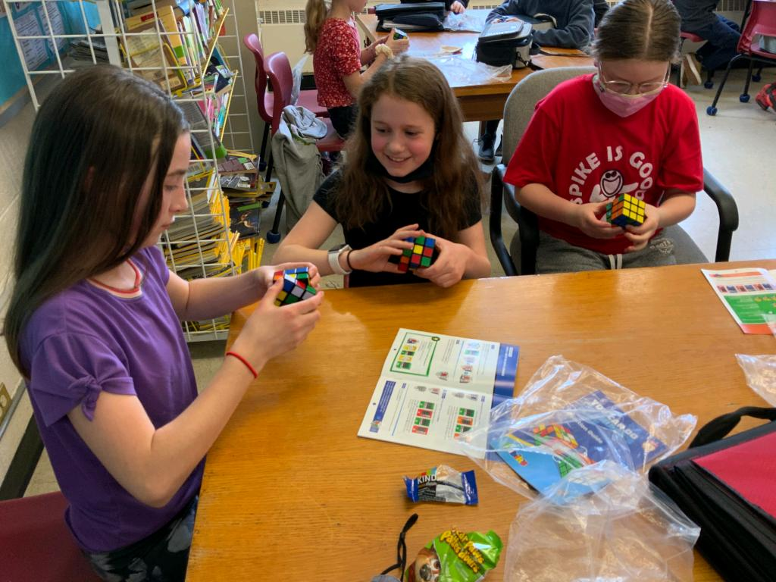
IMPORTANT INFO TO KNOW
TO PREPARE FOR DAY 1
This summer, keep an eye on our website for extra information.
https://secure1.nbed.nb.ca/sites/ASD-W/GeorgeSt/Pages/default.aspx

Slide 3
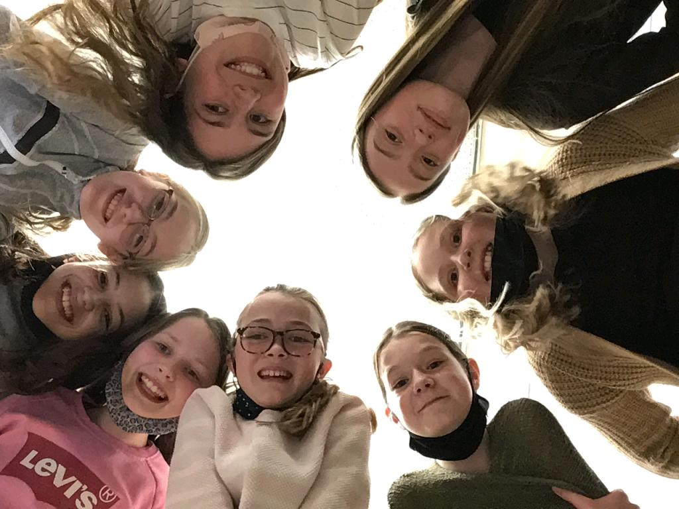
SCHOOL TOUR
CLICK SCHOOL TOUR TO ACCESS VIDEO

Slide 4
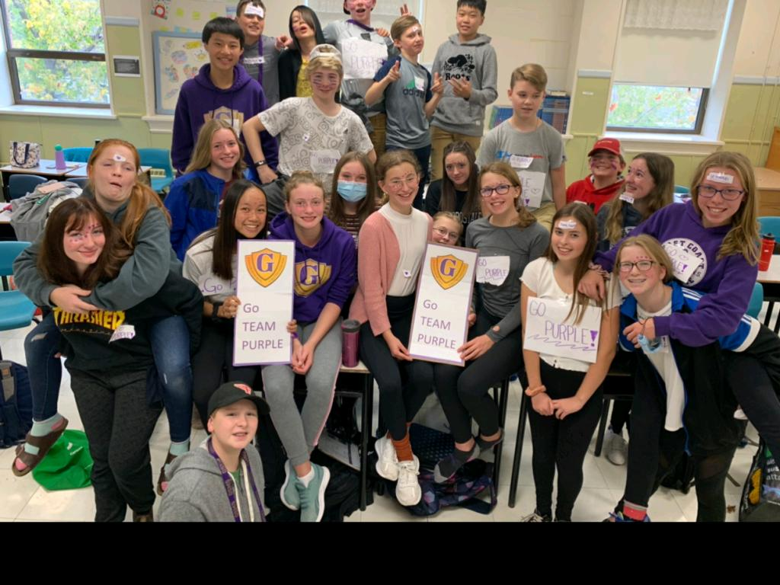
ASK GEORGIE
CLICK GEORGIE TO ACCESS VIDEO

Slide 5
ADVICE FORCLASS OF 2024
CLICK CLASS OF 2024 TO ACCESS VIDEO

